Slide 1

Lessons from a failed(?) startup

Slide 2
Steve Tauber
For hire?
Future Branch Development
Cuddli

Slide 3
Yes
Bunny Pics
Market Research
Funding
Team Composition
Non-US leverage

Slide 4
No
Ideas
Contracts / Legal
???

Slide 5
What is Cuddli?

Slide 6
Cuddli.ng

Slide 7
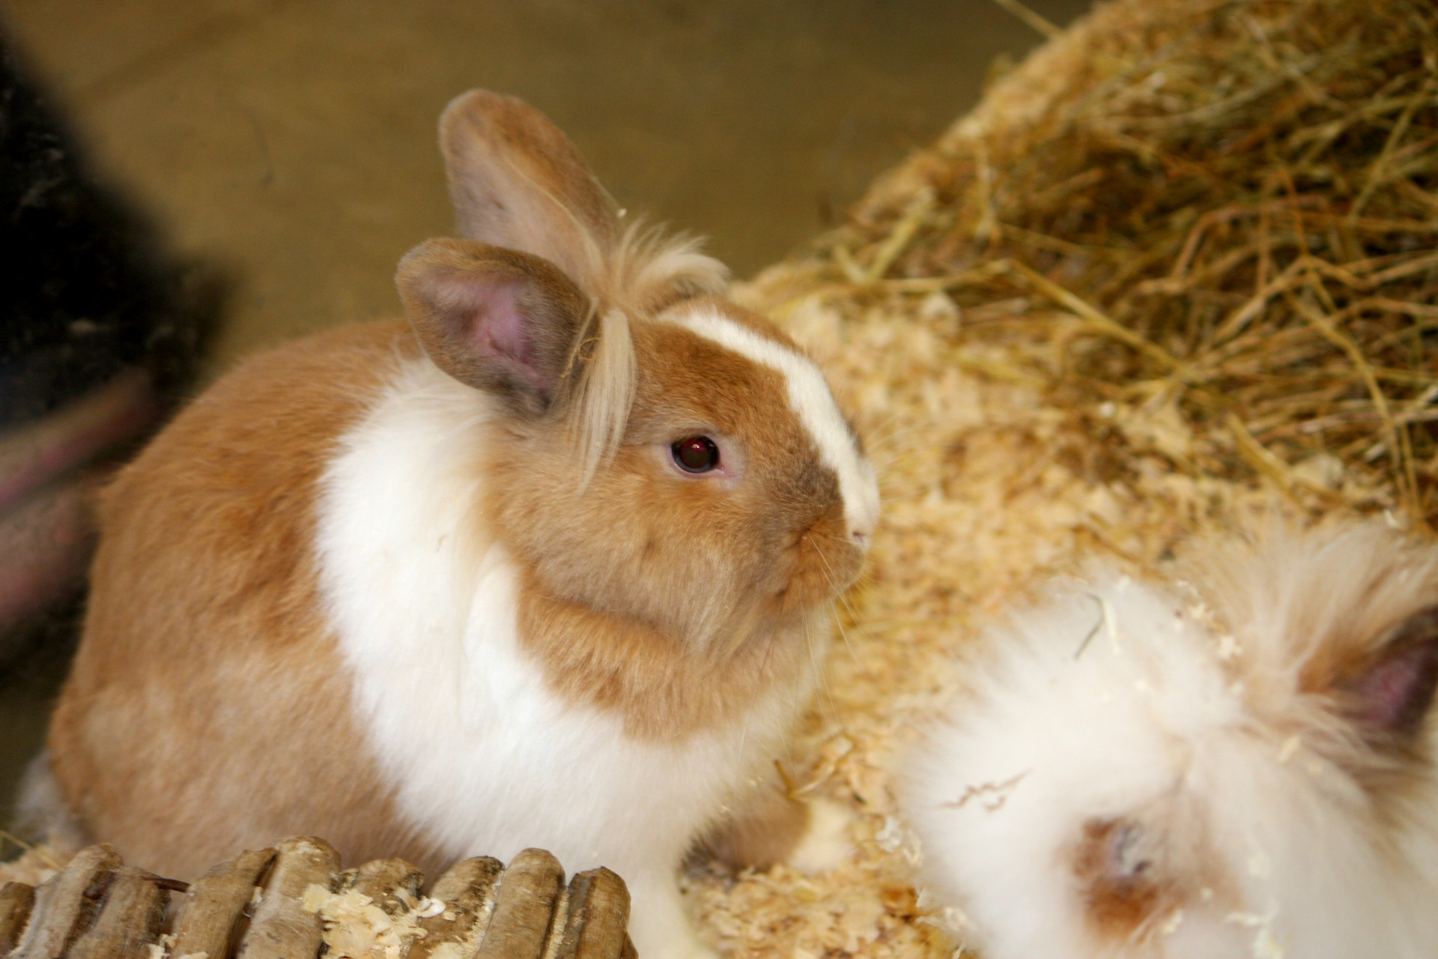

Slide 8
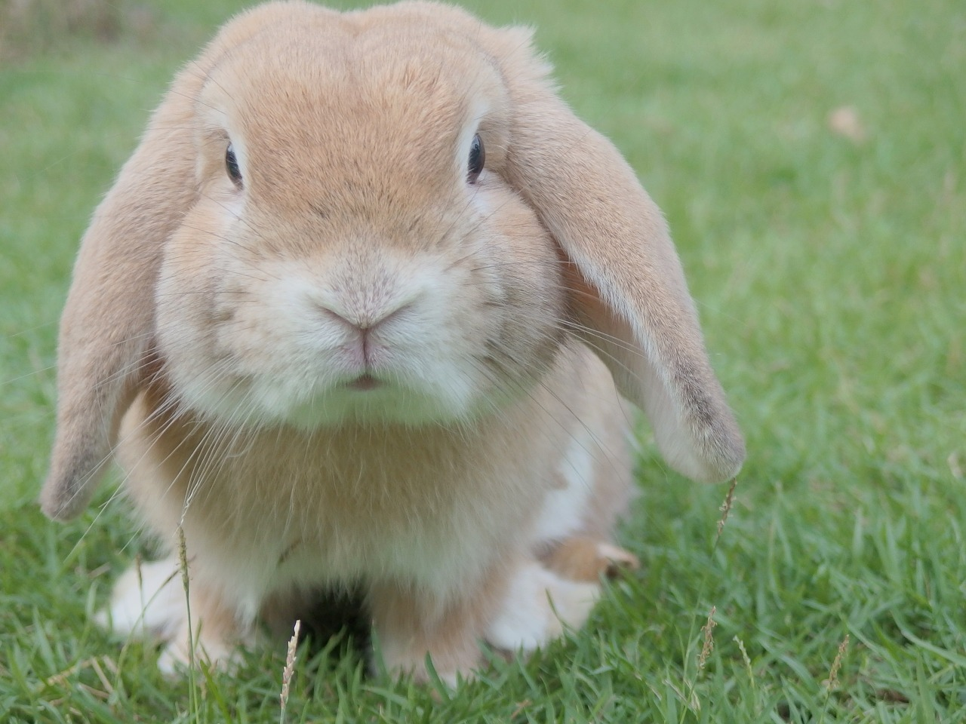

Slide 9
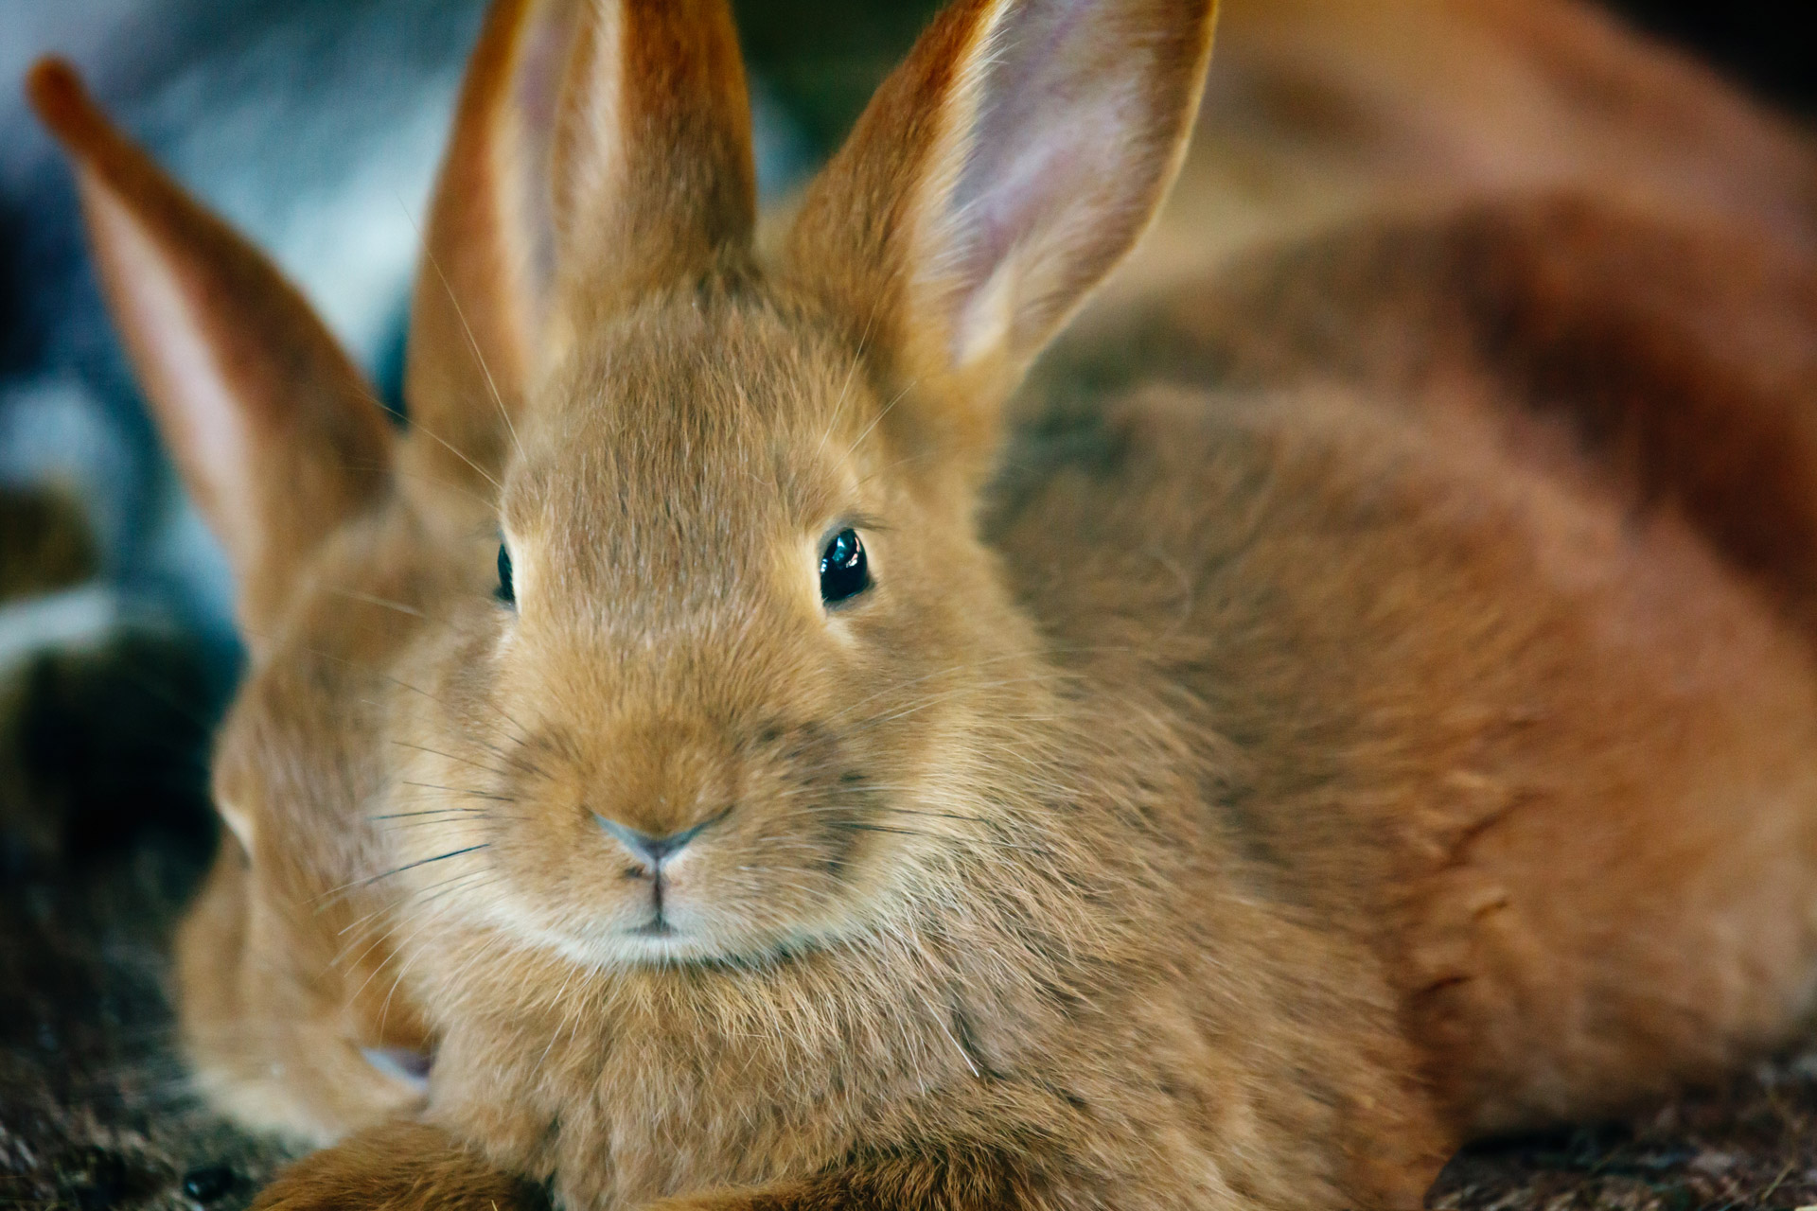

Slide 10


Slide 11


Slide 12


Slide 13


Slide 14
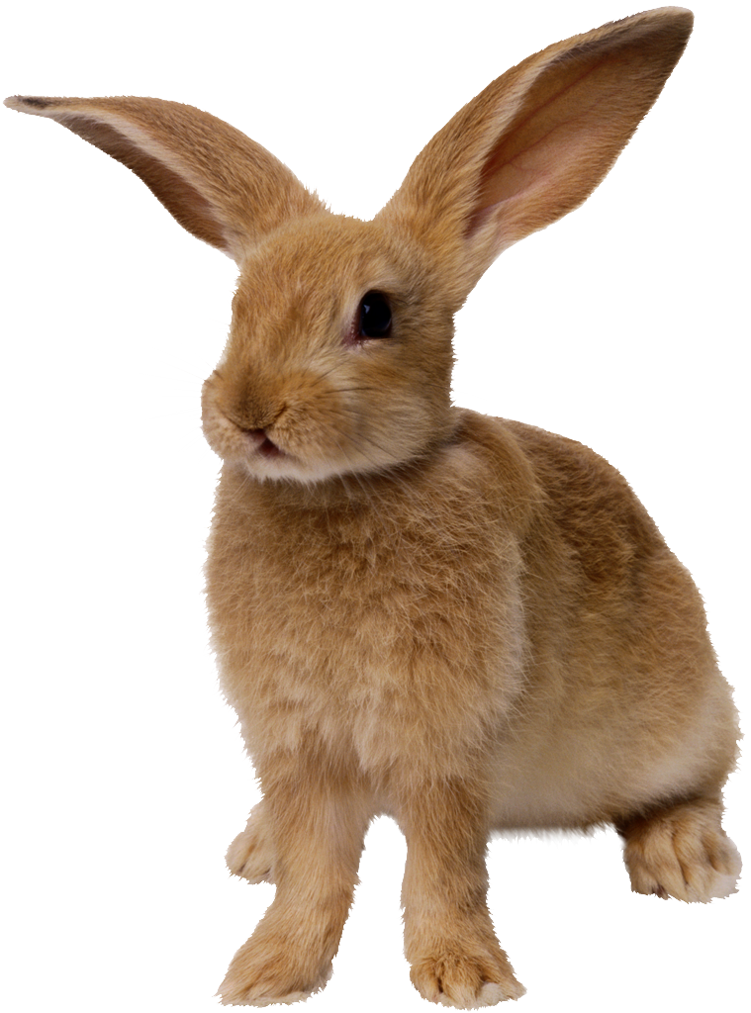

Slide 15
Features

Slide 16
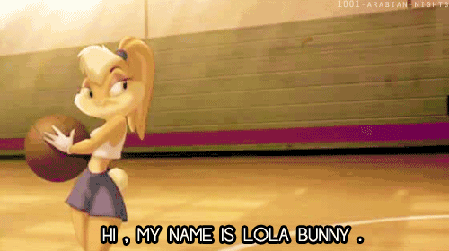
Notes:
Chatting

Slide 17
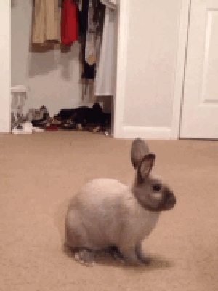
Notes:
Matching

Slide 19
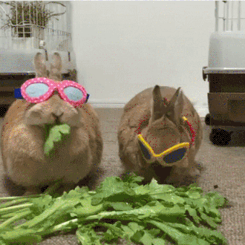
Notes:
Dates

Slide 20
Who likes this?

Slide 21
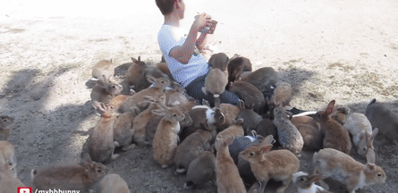
60,000+ users

Slide 22


Slide 23
Everything so far is wrong.

Slide 24
Step 1: Idea

Slide 25
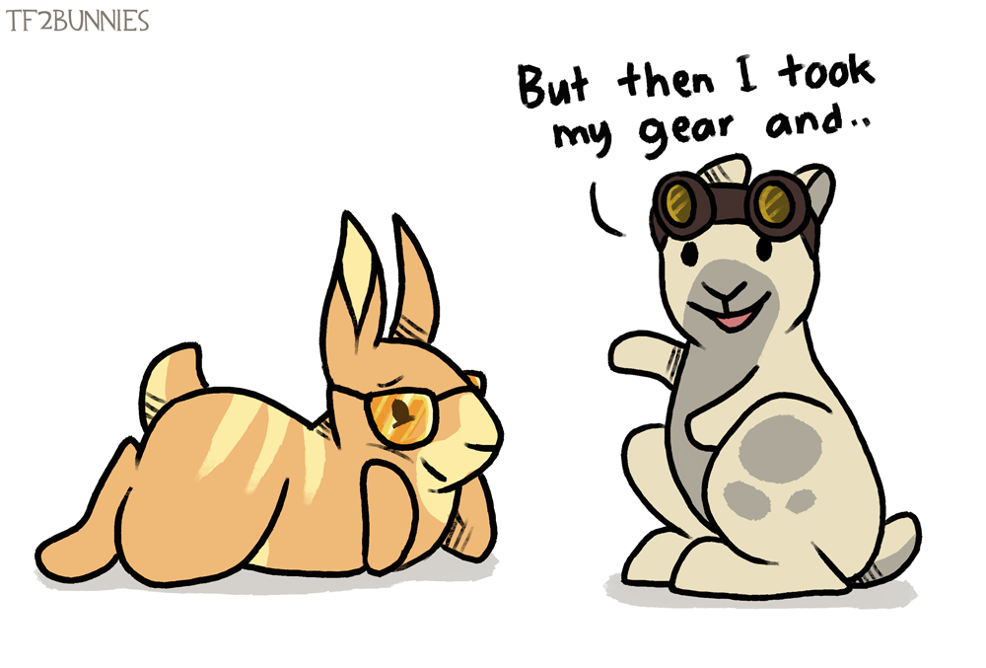

Slide 26
Step 1: Idea

Slide 27
Step 1: Idea Problem

Slide 28
Tier 1 Problem
Large
Urgent
$$$
Top 3?

Slide 29
Talk to people
About the problem
50+
Leading questions

Slide 30
Research time
About the problem
List of Competitors
Blue Ocean?

Slide 31
More Research
About the solution
10x better

Slide 32
More Research
About the solution
10x better AND quality matters
$$$
Kickstarter or Preorder

Slide 33
Step 2: The Business

Slide 34
Runway
How much $$$ you have
In months
“I have 6 months of runway”
18 months!!!

Slide 35
Business Plan
9 months
Growing Monthly Reoccurring Revenue (MRR)
Funding is failure!

Slide 36
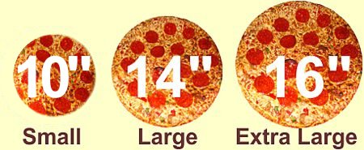
Pizza time

Slide 37
Pizza time
16”
10”
14”
50%
33%
25%

Slide 38
Pizza time
51
50
65
50%
33%
25%

Slide 39
Money time
$80
$10
$30
50%
20%
10%

Slide 40
Money time
$8
$5
$6
50%
20%
10%

Slide 41
Step 3: The Team

Slide 42
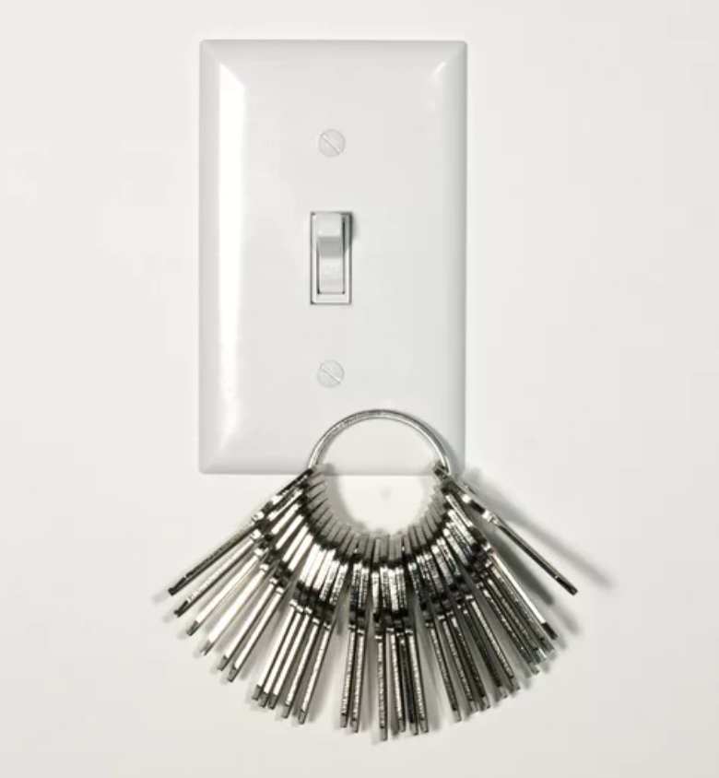

Slide 43
Marketing Expert
User Acquisition
PR
Social Media Marketing
Print Marketing

Slide 44
Technology Expert
SHIP
SHIP
SHIP
Hire the best you can

Slide 45
Mental Health
Depression
Divorce
Burn out
Addiction
Legal problems

Slide 46
3 years
Runway is 18 months
Revenue at month 9
Other 18 months???
No salary for 2 years!

Slide 47
Values
Friends first?
Work/Life balance?
Management styles?
Censorship and privacy of users?

Slide 48
Summary
Fix a problem
Have a plan
Build a team

Slide 49
Non-US Edge
Paying Salaries
Paying Rent
Easy pivots?
Low opportunity costs

Slide 50
Questions?

Slide 51
Photo Credits
https://pixabay.com/en/bunny-rabbit-easter-pet-animal-1149060/
https://www.flickr.com/photos/incredibleguy/5980129538
https://pixabay.com/en/laptop-tab-headphone-workstation-1483974/
https://pixabay.com/en/world-map-earth-global-continents-146505/
http://www.publicdomainpictures.net/view-image.php?image=82692&picture=cute-bunny-rabbit
http://www.publicdomainpictures.net/view-image.php?image=24094&picture=brown-rabbit
https://giphy.com/gifs/bunny-sp1y1MNrErO2Q
https://giphy.com/gifs/cute-rabbit-bunny-wsJHi6a1JwoXC
https://giphy.com/gifs/cno2xWuCqkG6A
https://giphy.com/gifs/bunnies-mNjQsaXdH5CMw
http://tf2bunnies.tumblr.com/post/110564923428/who-wouldnt-love-engineers-voice
https://giphy.com/gifs/bunnies-13HYukX8GcHBjG
https://giphy.com/gifs/election2016-donald-trump-election-2016-3oz8xLd9DJq2l2VFtu/download
http://fairdalepizza.com/
http://www.neo-cover.com/

